Slide 1
Test, Track and Trace
Liann Brookes-Smith
Associate Director Public Health

Slide 2
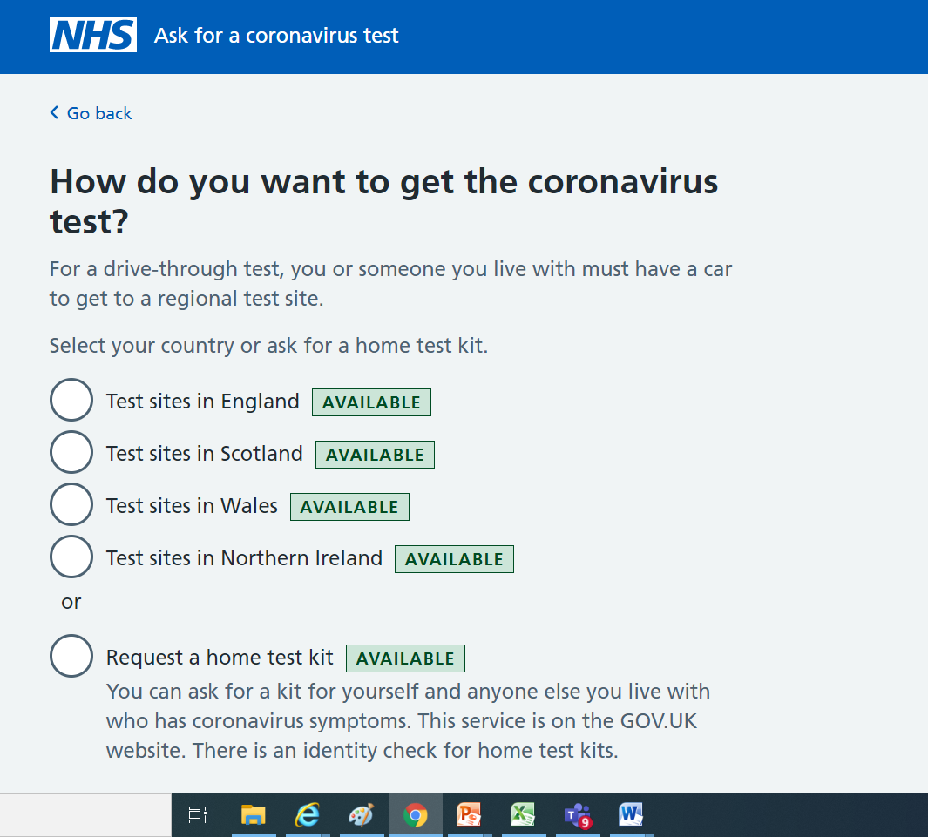
How to get tested?
https://www.nhs.uk/ask-for-a-coronavirus-test

Slide 3
